Slide 1
Network Protocols
Topic 8B

Slide 2
Learning Outcomes
By the end of this lesson, you should be able to:
Describe TCP/IP Transport-layer
Describe TCP/IP Internetwork-layer
Describe TCP/IP Network access layer

Slide 3
Transport Layer
TCP/IP

Slide 4
Transport-Layer Protocols
Transport-layer protocols are used with most Application-layer protocols because they:
Supply a header field to identify the Application layer
Provide reliability and flow control for applications that typically transfer a large amount of data

Slide 5
Role of the Transport Layer
The Transport layer has two protocols:
Transmission Control Protocol (TCP) is connection oriented and designed for reliable transfer of information in complex internetworks
User Datagram Protocol (UDP) is connectionless and designed for efficient communication of generally small amounts of data
Both protocols perform the following tasks:
Work with segments (TCP) or datagrams (UDP)
Provide a means to identify the source and destination applications involved in a communication
Protect data with a checksum

Slide 6
Role of the Transport Layer
Working with Segments and Datagrams
TCP works with units of data called “segments” and UDP work with units of data called “datagrams”
Both TCP and UDP add a header to data
The Transport-layer protocol then passes the segment to the Internetwork-layer protocol (usually IP)
With incoming data, the Internetwork-layer protocol de-encapsulates the packet and forwards the resulting segment or datagram to the Transport-layer protocol
The Transport-layer protocol processes it, de-encapsulates it, and sends the resulting data up to the Application layer

Slide 7
Role of the Transport Layer
Identifying Source and Destination Applications
How do computers keep track of incoming data when a Web browser, email application, chat and a word processing program are all running at the same time?
TCP and UDP use port numbers to specify the source and destination Application-layer protocols
Port numbers are 16-bit values assigned to specific applications running on a computer or network device
The Internet Assigned Numbers Authority (IANA) assigns a dedicated port number to every well-known network service

Slide 8
Role of the Transport Layer
Protecting Data with a Checksum
To protect data integrity, TCP and UDP provide a checksum similar to the CRC
Intermediate devices don’t recalculate the checksum in the Transport layer so if data corruption occurs during the transmission, the final receiving station detects the checksum error and discards the data

Slide 9
TCP: The Reliable Transport Layer
If an application requires reliable data transfer, it uses TCP as the Transport-layer protocol
TCP provides reliability by using these features that aren’t available in UDP:
Establishing a connection
Segmenting large chunks of data
Ensuring flow control with acknowledgements
TCP is a connection-oriented protocol
It establishes a connection with the destination, data is transferred, and the connection is broken

Slide 10
TCP: The Reliable Transport Layer
Establishing a Connection: The TCP Handshake
A TCP session begins when a client sends a TCP synchronization (SYN) segment to the destination device, usually a server
A destination port is specified and a source port is assigned dynamically
When the server receives the SYN segment, it responds by sending either an acknowledgement-synchronization (ACK-SYN) segment or a reset connection (RST) segment
An RST is sent when the server refused the request to open the session
If an ACK-SYN is returned, the client completes the three-way handshake by sending an ACK segment back to the server

Slide 11
TCP: The Reliable Transport Layer
Segmenting Data
When TCP receives data from the Application layer, the size might be too large to send in one piece
TCP breaks the data into smaller segments (max frame sent by Ethernet is 1518 bytes)
Each segment is labeled with a sequence number so that if segments arrive out of order they can be reassembled in the correct order

Slide 12
TCP: The Reliable Transport Layer
Ensuring Flow Control with Acknowledgments
Flow control prevents a destination from becoming overwhelmed by data, resulting in dropped packets
TCP establishes a maximum number of bytes, called the “window size”, that can be sent before the destination must acknowledge the receipt of data
If no acknowledgement is received within a specified period of time, the sending station will retransmit from the point at which an acknowledgement was last received

Slide 13
Internetwork Layer
TCP/IP

Slide 14
Internetwork-Layer Protocols
The Internetwork layer is where administrators usually do the most network configuration
This layer is where the IP protocol operates and is the heart of the TCP/IP protocol suite
The Internetwork layer is responsible for four main tasks:
Defines and verifies IP addresses
Routes packets through an internetwork
Resolves MAC addresses from IP addresses
Delivers packets efficiently

Slide 15
Defines and Verifies IP Addresses
An IP address is assigned to every computer and network device using TCP/IP for communications
IP addresses are used for two main purposes:
To identify a network device at the Internetwork layer
To identify the network on which a device resides
When a device receives an IP packet, it compares the destination IP address with it’s own:
If it matches or is a broadcast, the packet is processed
It is does not match then it is discarded
Every IP address contains two parts:
A network ID
A host ID

Slide 16
Routes Packets through an Internetwork
The Internetwork layer determines the best way to get a packet from network to network until it reaches its destination
Most large internetworks (the Internet) have multiple paths for getting from one network to another
Routers work at the Internetwork layer and it is their job to select the best path to the destination
Routers use the network ID portion of IP addresses along with their routing tables to determine the best path

Slide 17
Resolves MAC Addresses from IP Addresses
Every frame contains both physical (MAC) and logical (IP) source and destination addresses
When a packet is ready to be sent to the Network access layer, the destination device’s MAC address must be retrieved before the frame header can be constructed
TCP/IP uses Address Resolution Protocol (ARP) to find MAC addresses
ARP is discussed in more detail later in the chapter

Slide 18
Delivers Packets Efficiently
Internetwork-layer protocols primarily focus on efficient delivery of packets
Features such as flow control, delivery confirmation or message assembly are not included in Internetwork-layer protocols
These features require overhead to ensure reliable delivery
Internetwork-layer protocols rely on the protocols in the Transport and Application layers to provide reliability features
Is considered a connectionless protocol, which relies on upper-layer protocols to ensure the packet’s safe journey

Slide 19
Protocols at the Internetwork Layer
Some of the most commonly used Internetwork-layer protocols:
IPv4
IPv6
ARP
ICMP
IPsec

Slide 20
Protocols at the Internetwork Layer
Internet Protocol Version 4
IPv4 is also known as “IP”
IPv4 is the most common version in networks and the first version that was in widespread use
It defines a 32-bit dotted decimal IP address
Example: 172.31.149.10
Important fields in an IP packet:
Version
Time to live (TTL)
Protocol
Checksum
Source and Destination address

Slide 21
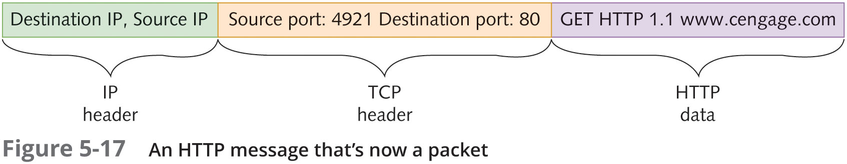
Protocols at the Internetwork Layer

Slide 22
Protocols at the Internetwork Layer
Internet Protocol Version 6
Uses a different format for IP addresses than IPv4
IPv6 can run alongside IPv4 without needing to change the Transport Layer or Network Access Layer
Improvements and changes from IPv4:
Larger address space
Hierarchical address space
Autoconfiguration
Built-in Quality of Service (QoS) support
Built-in support for security
Support for mobility
Extensibility

Slide 23
Protocols at the Internetwork Layer
Address Resolution Protocol
Address Resolution Protocol (ARP) is used to resolve a logical (IP) address to physical (MAC) address
When a source doesn’t have the destination’s MAC it sends out an ARP broadcast frame requesting the MAC address corresponding to the host’s IP address
A network device configured with the specified IP address responds with an ARP reply containing its MAC address
To avoid sending an ARP request every time, PCs and other devices store learned IP address/MAC address pairs in an ARP cache which is a temporary location in RAM

Slide 24
Protocols at the Internetwork Layer
Address Resolution Protocol (continued)
If the destination computer is on another network:
The computer uses ARP to retrieve the MAC address of the router configured as its default gateway
The packet is delivered to the router and the router determines where the packet should go next to get to its destination

Slide 25
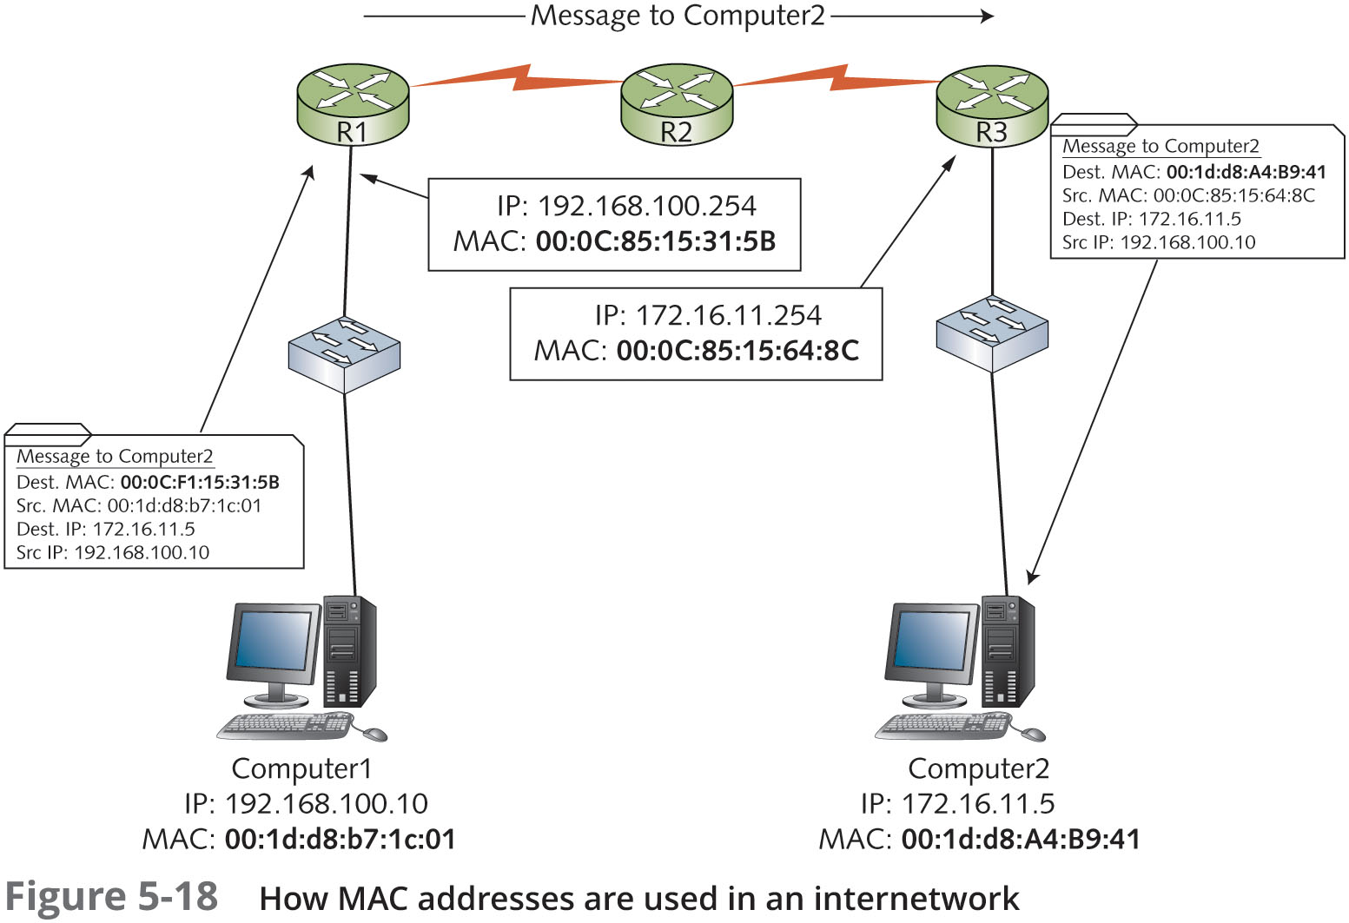
Protocols at the Internetwork Layer

Slide 26
Protocols at the Internetwork Layer
Internet Control Message Protocol
Internet Control Message Protocol (ICMP) is used to send error, status, and control messages between systems or devices
ICMP is a specialized IP packet with its own header
The ping program uses ICMP Echo packets to request a response from another computer or to verify whether it is available for communication
A ICMP Echo Reply packet indicates whether the host is reachable and how long the message’s round trip from sender to receiver took
The tracert program uses ICMP Echo packets to determine the route a packet takes through an internetwork

Slide 27
Protocols at the Internetwork Layer
Internet Protocol Security
Internet Protocol Security (IPsec) works with IPv4 to ensure secure delivery of packets
IPsec can be used to secure sensitive network transmissions between computers that need extra security
This protocol provides security by using authentication and encryption
IPsec requires additional network/computer resources, so it should be enabled only for highly sensitive communication and in environments where security risks are high

Slide 28
Network Access Layer
TCP/IP

Slide 29
Network Access Layer
Some tasks performed by the Network access layer:
Provides a physical (MAC) address for the network interface
Verifies incoming frames have the correct destination MAC address
Defines and follows media access rules
Receives packets from the Internetwork layer and encapsulates them to create frames
De-encapsulates received frames and sends the resulting packets to the Internetwork layer
Often provides frame error detection in the form of a CRC code
Transmits and receives bit signals
Defines the signaling needed to transmit bits, whether electrical, light pulses, or radio waves
Defines the media and connectors needed to make a physical network connection

Slide 30
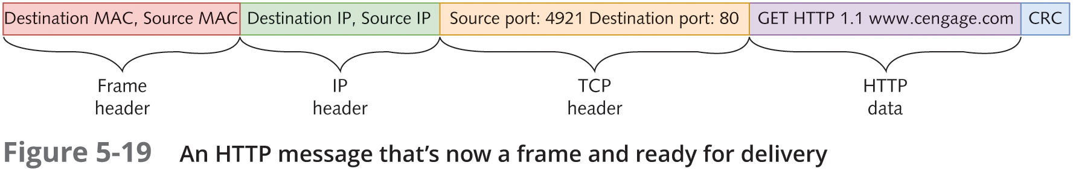
Network Access Layer

Slide 31
Summary
TCP/IP is the main protocol suite used in networks
TCP/IP takes a layered approach and is organized in four layers
The Transport layer provides reliability and works with segments (TCP) and datagrams (UDP)
Transport-layer protocols supply a header field to identify the Application layer and provide reliability and flow control
The Internetwork layer is where most network configuration occurs and is composed of IP, ICMP, and ARP
This layer is responsible for four main tasks: defining and verifying IP addresses, routing packets through an internetwork, resolving MAC addresses from IP addresses, and delivering packets efficiently
The Network access layer is composed of network technologies, such as Ethernet and WAN technologies
Some tasks performed include providing a physical (MAC) address for the network interface, verifying that incoming frames have the correct destination MAC address, receiving packets from the Internetwork layer and encapsulating them to create frames, and transmitting and receiving bit signals

